Slide 1


INTRODUCTION TO LOCATION BASED SERVICES
By Rahul Nandkumar (RA1911001010052)

Slide 2
WHAT IS A LOCATION BASED SERVICE?
A location based service (LBS) is a software service for mobile device applications that require knowledge about where the mobile device is geographically located.
Location-based services integrate data from various resources, including Global Positioning System (GPS) satellites, cellular tower pings and short-range positioning beacons, to provide services based on the user's geographical location.

Slide 3
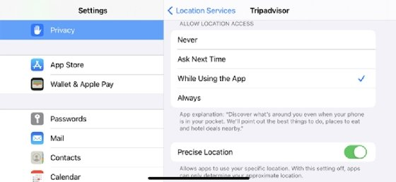
For location-based services to operate, the following four basic components are required:
An application that uses location-based services.
A positioning mechanism to collect geodata.
A mobile network to transmit or receive data.
Analytics software running on a remote server to compute and deliver relevant data to the user based on geographic location.
By law, location-based services must be permission-based, so the end user must opt in to the service in order to use it. In most cases, this means the user turns on the location-based service application and accepts a request to enable the service to know the device's location.

Slide 4
GOOGLE MAPS V2 SERVICES USING GOOGLE API
Allows your users to explore the world with rich maps provided by Google. It helps identify locations with custom markers, augments the map data with image overlays, embeds one or more maps as fragments, and much more.
Key features:
Adds maps to your app
Customizes the map
Controls the user's view
Adds Street View to your app

Slide 5
With Google Maps Android API v2, you can embed maps into an activity as a fragment with a simple XML snippet. It offer exciting features such as 3D maps; indoor, satellite, terrain, and hybrid maps; vector-based tiles for efficient caching and drawing; animated transitions; and much more.
With this API we can define custom colors or icons for your map markers to match your app's look and feel. To further enhance the app, draw polylines and polygons to indicate paths or regions, or provide complete image overlays
Provides your users with a different view of the world with the ability to control the rotation, tilt, zoom, and pan properties of the "camera" perspective of the map.

Slide 6
THANK YOU !

